Slide 1

Project Title: Library Management System
Present by
Sudhir Baliram Kadam
July Batch 2023

Slide 2
Content
Abstract
Introduction
Objectives
Tools and technologies
Modules
Advantages
Future scope
2

Slide 3
1. Abstract
Main goal to build Library Management System is operate library efficiently with the software. This software will keep all records of about books and students in file and we can easily fetch all data at any point of time. The library management system software helps in reducing operational costs. Managing a library manually is labor intensive and an immense amount of paperwork is involved so this automated system reduces the need for manpower and stationery. This leads to lower operational cost also.
3

Slide 4

2. Introduction
What is Library Management System ?
A library management system is software that is designed to manage all the functions of a library. It helps librarian to maintain the data of new books and the books that are borrowed by members along with their due dates.
The best way to maintain, organize, and handle countless books systematically is to implement a library management system software.
4

Slide 5
3. Objective
The objective to build the library management system is to keep book records digitally which will benefit the students as well as the staff of the library.
It also has a login facility so its secure and unauthorized users can not use it.
This library management system is used to reduce the paper work, man power and stationery.
This system makes staff of the library to work efficiently with library management.
5

Slide 6
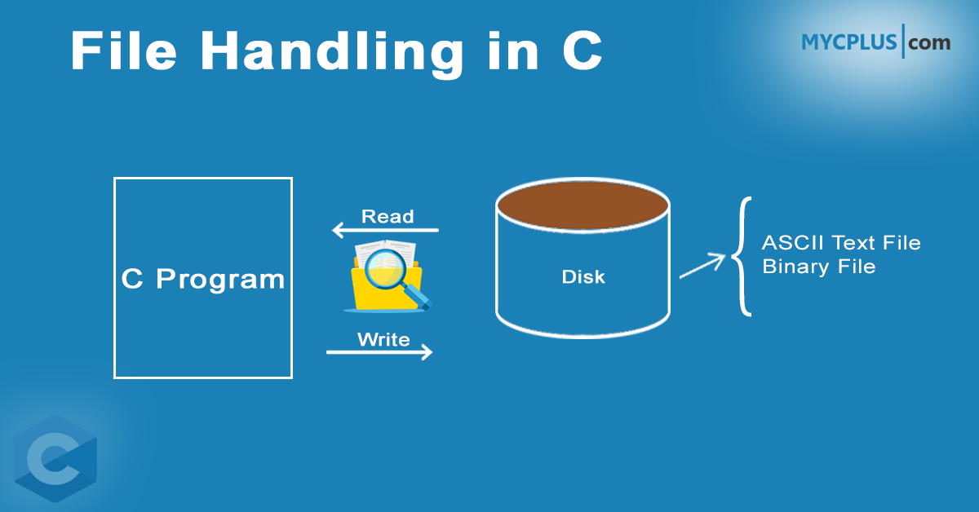
4. Tools and technologies
This is open source project.
Dev cpp code editor.
In this project c programing language is used for development of project.
File handling is used to store data .
6

Slide 7
5.Modules
Login module:- function-void password()
In this module user login designed with username and password user can login into the application.
Main menu module:- function- void mainmenu()
This module is used to show the main menu the library management system.
Add book module:- function- void addbooks()
This module is used to add books in the file. Book has different fields like id, book name, author name, price, Quantity, rackno, etc.
7

Slide 8
5.Modules
Delete book module:- function- void deletebooks()
This module is designed to delete the specific book record by book id.
Search book module:- function – void searchbooks()
This module is used to search a book record by the book id.
Issue book module:- function- void issuebooks()
This module is used to keep records of issued books with fields like book id, book name, student name, category, issue date and due date etc. in this we have two choices add issue record and view issue record.
View books module:- function – void viewbooks()
This module is used to show all records list.
8

Slide 9
5.Modules
Edit book record module:- function- void editbooks()
This module is used to edit the records by the book id. All the data related to book is edited in this module.
Close application module:- function- void closeAppliction()
This module is used for close the application exit() function is used to close the application.
9

Slide 10
6.Advantages
library management system is used to keep book records digitally.
It reduces the paper work, man power required to manage libraries and stationary.
It makes librarian to manage library work efficiently.
It also has a login facility so its secure unauthorized users can not use it.
10

Slide 11
Future scope
This library management system provides a computerized version of library management which will benefit the students as well as the staff of the library. It makes entire process online where all data of books is stored digitally. It also has a login facility so its secure unauthorized users can not use it.
There is a future scope of this facility that many more features can be added, such as books record can be stored as department wise, books can be search by book name, etc.
There are drawbacks using file handling so we can develop this library management system in other programing language(ex. Java, Python, etc.) and use database to keep book records in backend thus making it more interactive more user friendly and project which fulfills each users need in the best way possible.
11

Slide 12


